Slide 1
بسم الله الرحمن الرحیم
Notes:
Introduce yourself
ان شاء الله که وخت خوب و پربرکت خواهیم داشت

Slide 2
CS101 Introduction to Computer Science

Slide 3
Lecture 6

Slide 4
conditionals

Slide 5
operators

Slide 6
variables

Slide 7
loops
Notes:
cat0.c

Slide 8
control-c

Slide 9
scope
Notes:
cat9.c

Slide 10
Linux

Slide 11
correctness, design, style

Slide 12
function
arguments →
→ side effects

Slide 13


Slide 14

Notes:
mario{0,1}.c

Slide 15


Slide 16
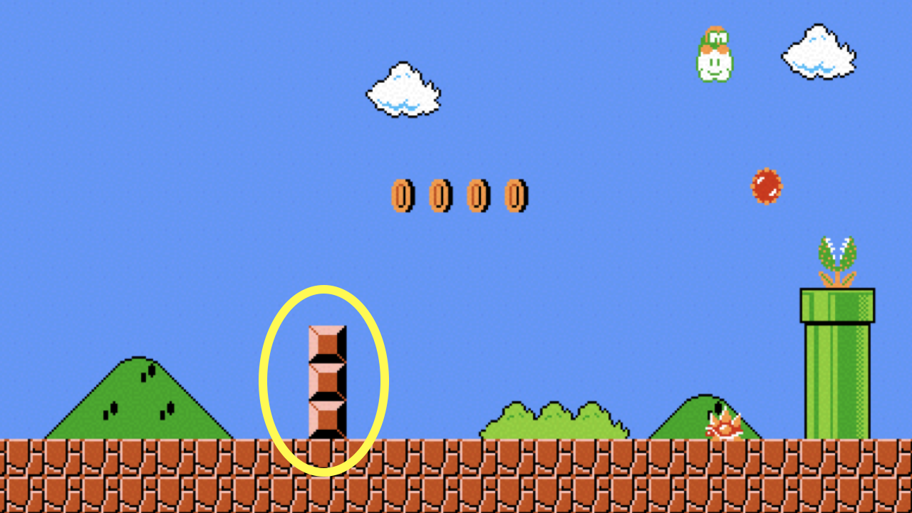
Notes:
mario2.c

Slide 17


Slide 18
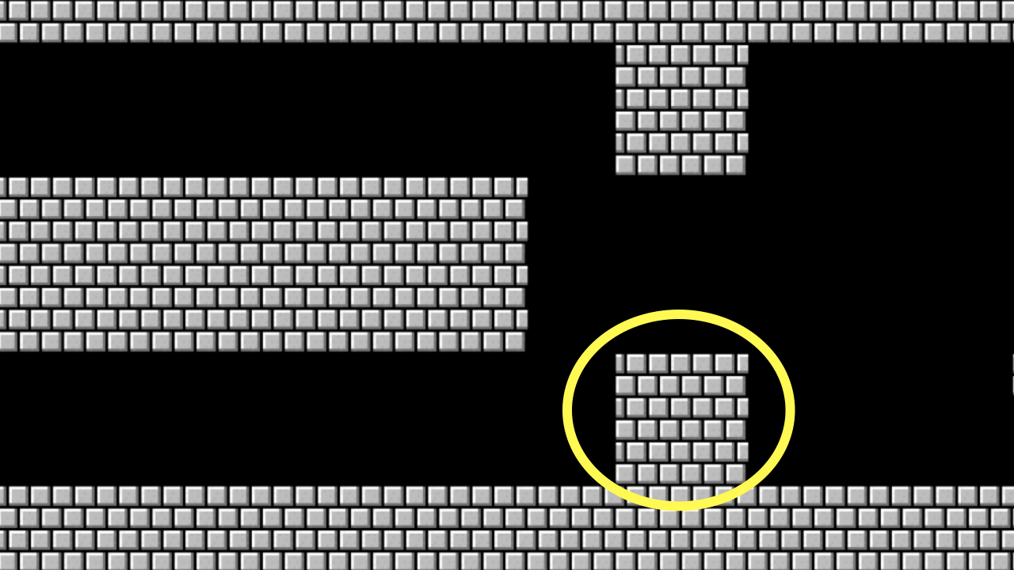
Notes:
mario{3,4,5}.c

Slide 19
constants

Slide 20
comments

Slide 21
function
arguments →
→ return value

Slide 22
+
-
*
/
%
…
Notes:
calculator*.c

Slide 23
integer overflow

Slide 24
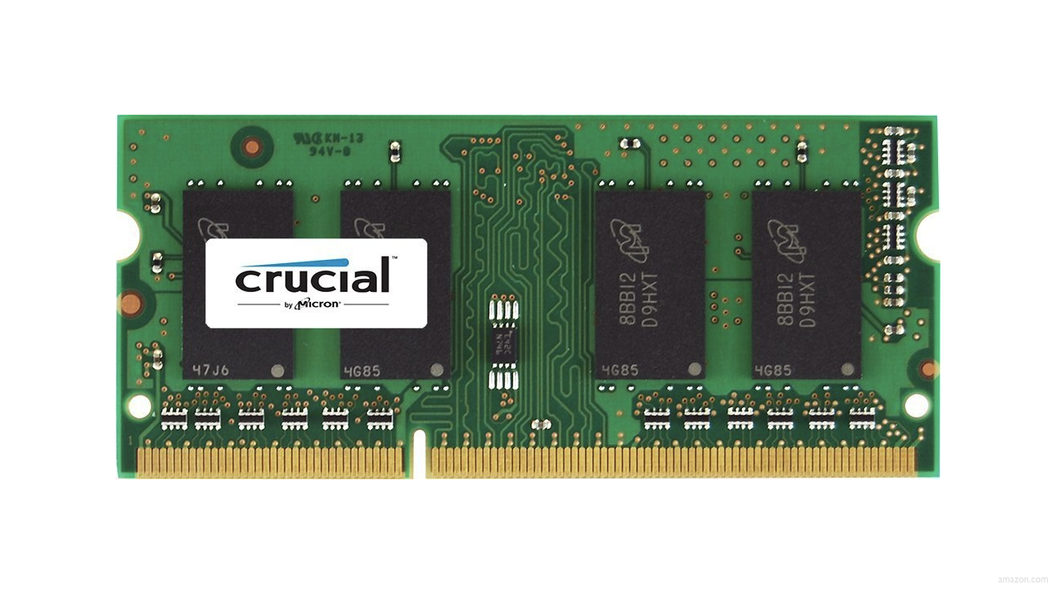

Slide 25
000

Slide 26
995

Slide 27
996

Slide 28
997

Slide 29
998

Slide 30
999

Slide 31
1000

Slide 32
1001

Slide 33
1002

Slide 34
1003

Slide 35
0000

Slide 36
0001

Slide 37
0010

Slide 38
0011

Slide 39
0100

Slide 40
0101

Slide 41
0110

Slide 42
0111

Slide 43
1000

Slide 44
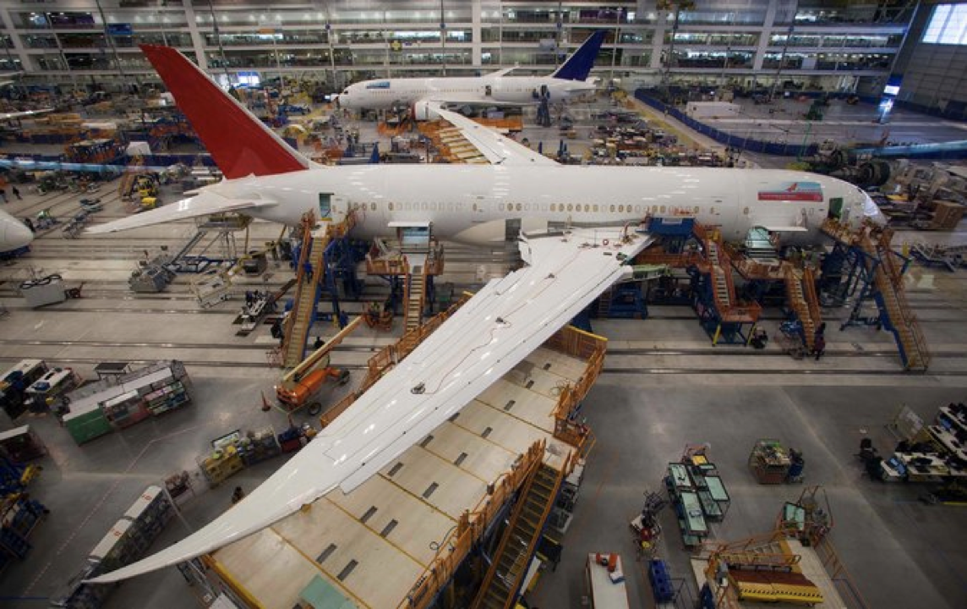
Notes:
Boeing 787
"a Model 787 airplane that has been powered continuously for 248 days can lose all alternating current (AC) electrical power due to the generator control units (GCUs) simultaneously going into failsafe mode," the memo stated. "This condition is caused by a software counter internal to the GCUs that will overflow after 248 days of continuous power... Boeing is in the process of developing a GCU software upgrade that will remedy the unsafe condition." - http://arstechnica.com/information-technology/2015/05/boeing-787-dreamliners-contain-a-potentially-catastrophic-software-bug/
A simple guess suggests the the problem is a signed 32-bit overflow as 2^31 is the number of seconds in 248 days multiplied by 100, i.e. a counter in hundredths of of a second.
https://www.i-programmer.info/news/149-security/8548-reboot-your-dreamliner-every-248-days-to-avoid-integer-overflow.html

Slide 45
truncation

Slide 46
floating-point imprecision
Notes:
1/3

Slide 47
1999
Notes:
graduated

Slide 48
1999

Slide 49
1900

Slide 50
19 January 2038

